Slide 1

Saijo European Youth Go Tour Stage 1
Vatra Dornei, 3-5 Feb, 2019
www.eurogofed.org/seygo

Slide 2
98 children and youth players in the Open
U20 – 8 players in the „knock-out” in rounds 4-6
U16 – 16 players in the „knock-out” in rounds 3-6
U12 – 32 players in the „knock-out” in rounds 2-6
+ 20 children in Beginners section
www.eurogofed.org/seygo

Slide 3
U20 KO8 Winner: Oscar Vasquez, 5d

Slide 4
U16 KO16 Winner: Ioan Arsionaia, 2d

Slide 5
U12 KO32 Bracket 1

Slide 6
U12 KO32 Bracket 2
U12 FINALS: WINNER Dragos Boldeanu, 1d

Slide 7
Prizes: 1.400 EUR (vouchers)
www.eurogofed.org/seygo

Slide 8
Aditional Special Prizes: 490 EUR (Internet go school)
www.eurogofed.org/seygo

Slide 9
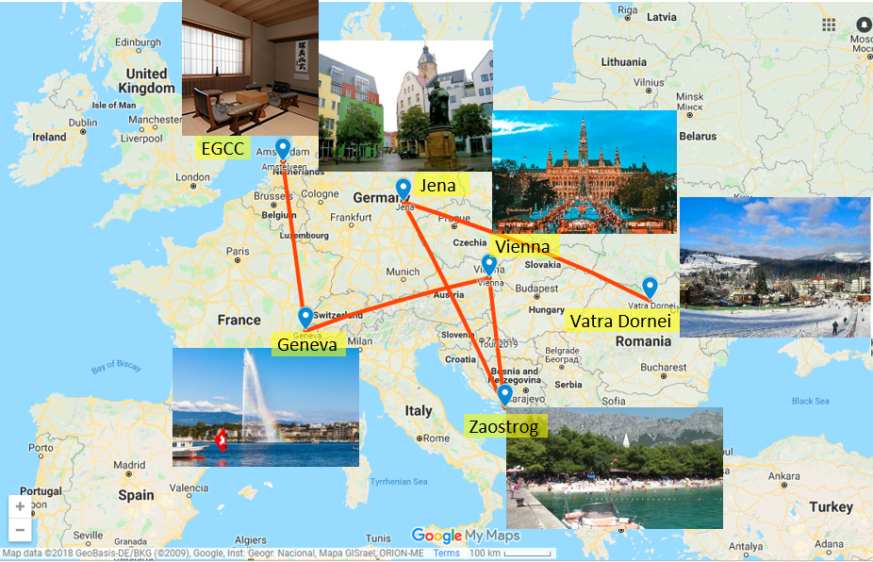
SEYGO Tour 2019 - RoadMap

